Slide 1
Top Gun Project DL950 Success Stories
2025-02-18

Slide 2
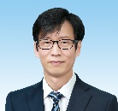
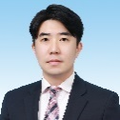

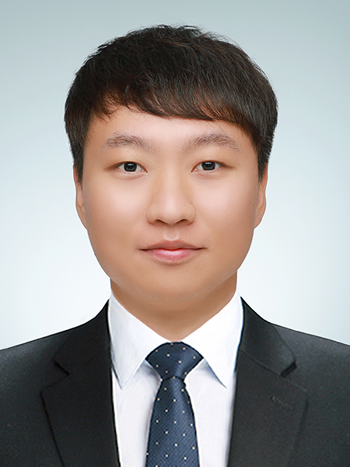

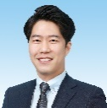
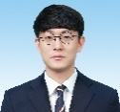
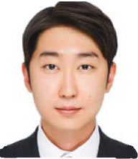
T&M System Dept. Organizations
DY
KIM
T&M SYS Dept. Manager Team Leader
Project Management, Risk Management
YG
NOH
Hardware Part Part Leader & Project Leader
H/W design drawing and sales assistant
Involved in HW part of all system
SW
BAE
Software Part Part Leader & Project Leader
C# BASE based engineer
Total career about 17 years
KJ
KIM
EJ
CHOI
SB
JUNG
JJ
PARK
DH
AHN
Project Assistant
H/W design drawing
and sales assistant
Project Assistant
Schedule Management
and sales assistant
Project Leader
LABVIEW based Engineer
Total career about 16 years
Project Leader
LABVIEW based Engineer
Total career about 14 years
LG MAGNA ICCU Project
Project Assistant
LABVIEW based Engineer
Total career about 5 years
SL Wire-less Charge Prj
Kyungshin Li-ion Battery Prj

Slide 3
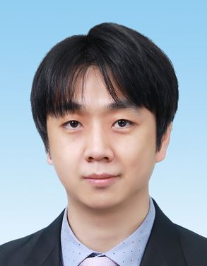
Self introduction
Profile
Career
Power Noise Simulator
Hyundai mobis, Samsung SDI
Battery TEST system
Samsung SDI
Camera durability test system
Hyundai mobis, LG Innotek
Thermoelectric module and Peltier element efficiency and durability tester
Hyundai
Grid PV Simulator
Hanwha
Name : BAE Seong woo(裵成友)
E-mail : seongwoo.bae@yokogawa.com
Birthday : 1980.05.03
Place of birth : Busan, Korea
Work(Assigned Task)
Develop programs to implement customer systems or services
Development Language : C++, C#, JAVA

Slide 4

DL950 Success Stories
Client
YURA TECH
auto parts manufacturer
(Major customers are Hyundai/Kia Motors and Hyundai Mobis.)
DL950 Sales volume – 6EA
Spark plug System
DL950-F-HK - 5EA
720211 20MHz -15EA
C60 SFP+ - 5EA
700929 Probe 1000 V - 30EA
701933 Current Probe 30A 50MHz - 5EA
Pre-charge Relay System
DL950-F-HK/M1 - 1EA
720268 1MS/s - 5EA
758933 Measurement lead set - 3EA
701904 1:1 Safety adapter lead - 3EA
758921 Fork Terminal adapters - 6EA
720256 4CH 10MS/s 12Bit Isolation Module - 1EA
CT60 Current Transducer(60Apeak) - 3EA
VZ20X -1EA
701930 Current Probe -1EA

Slide 5
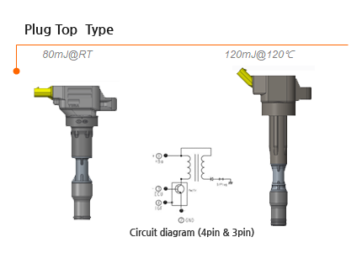
DL950 Success Stories
Spark plug durability System
Customer Requirements
Load resistance: 10Mohm
Maximum voltage: 50kV
30CH normal operation and current level measurement
Group 5EA each and determine whether the ignition coil is operating by measuring the current of the entire group.
Provides 6 months of Hyundai Motor Company requirement waveform data storage
The core driving device of an engine that generates high-voltage current to cause spark discharge inside the engine.
DUT - Spark plug
Notes:
30CH 작동 및 전류 측정
그룹 5EA 각각 전체 그룹의 전류를 측정하여 점화 코일이 작동하는지 확인합니다.
엔진내부에서 불꽃 방전을 일으키기 위한 고전압 전류를 발생시키는 엔진의 핵심 구동장치

Slide 6
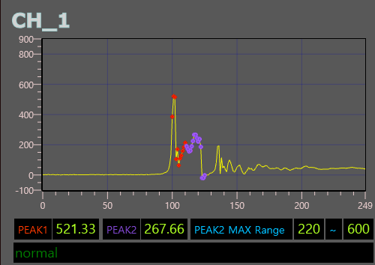
DL950 Success Stories
Spark plug durability System – S/W Program
Waveform display(2M Sampling, Point-Point 2us )
1st peak measurement
2nd peak measurement
2nd peak - Reading by range
- Normal range normal display
- Over display outside normal range
- 2nd peak Range: User configurable

Slide 7
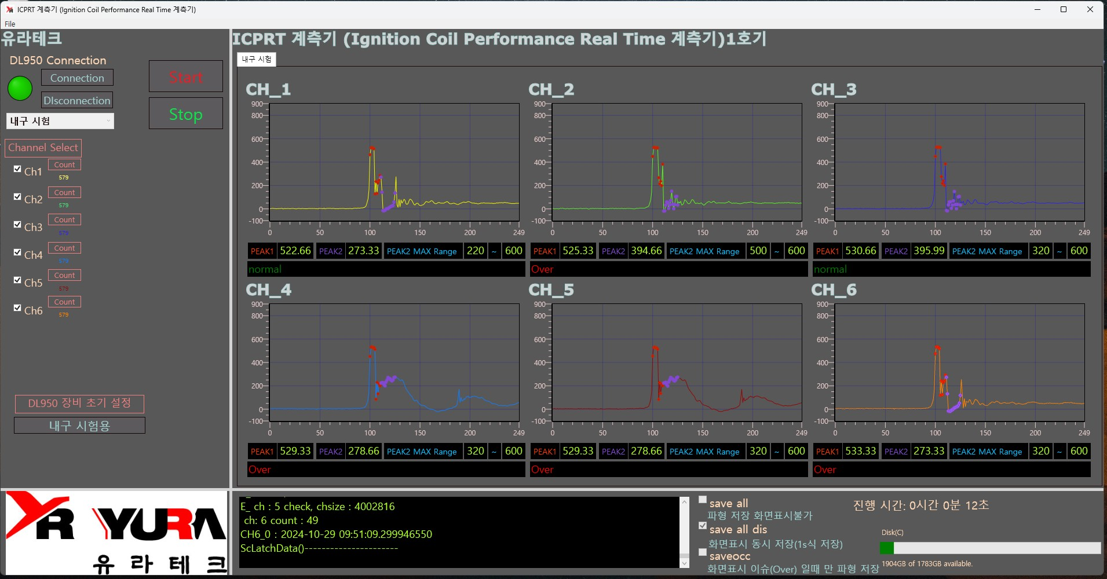
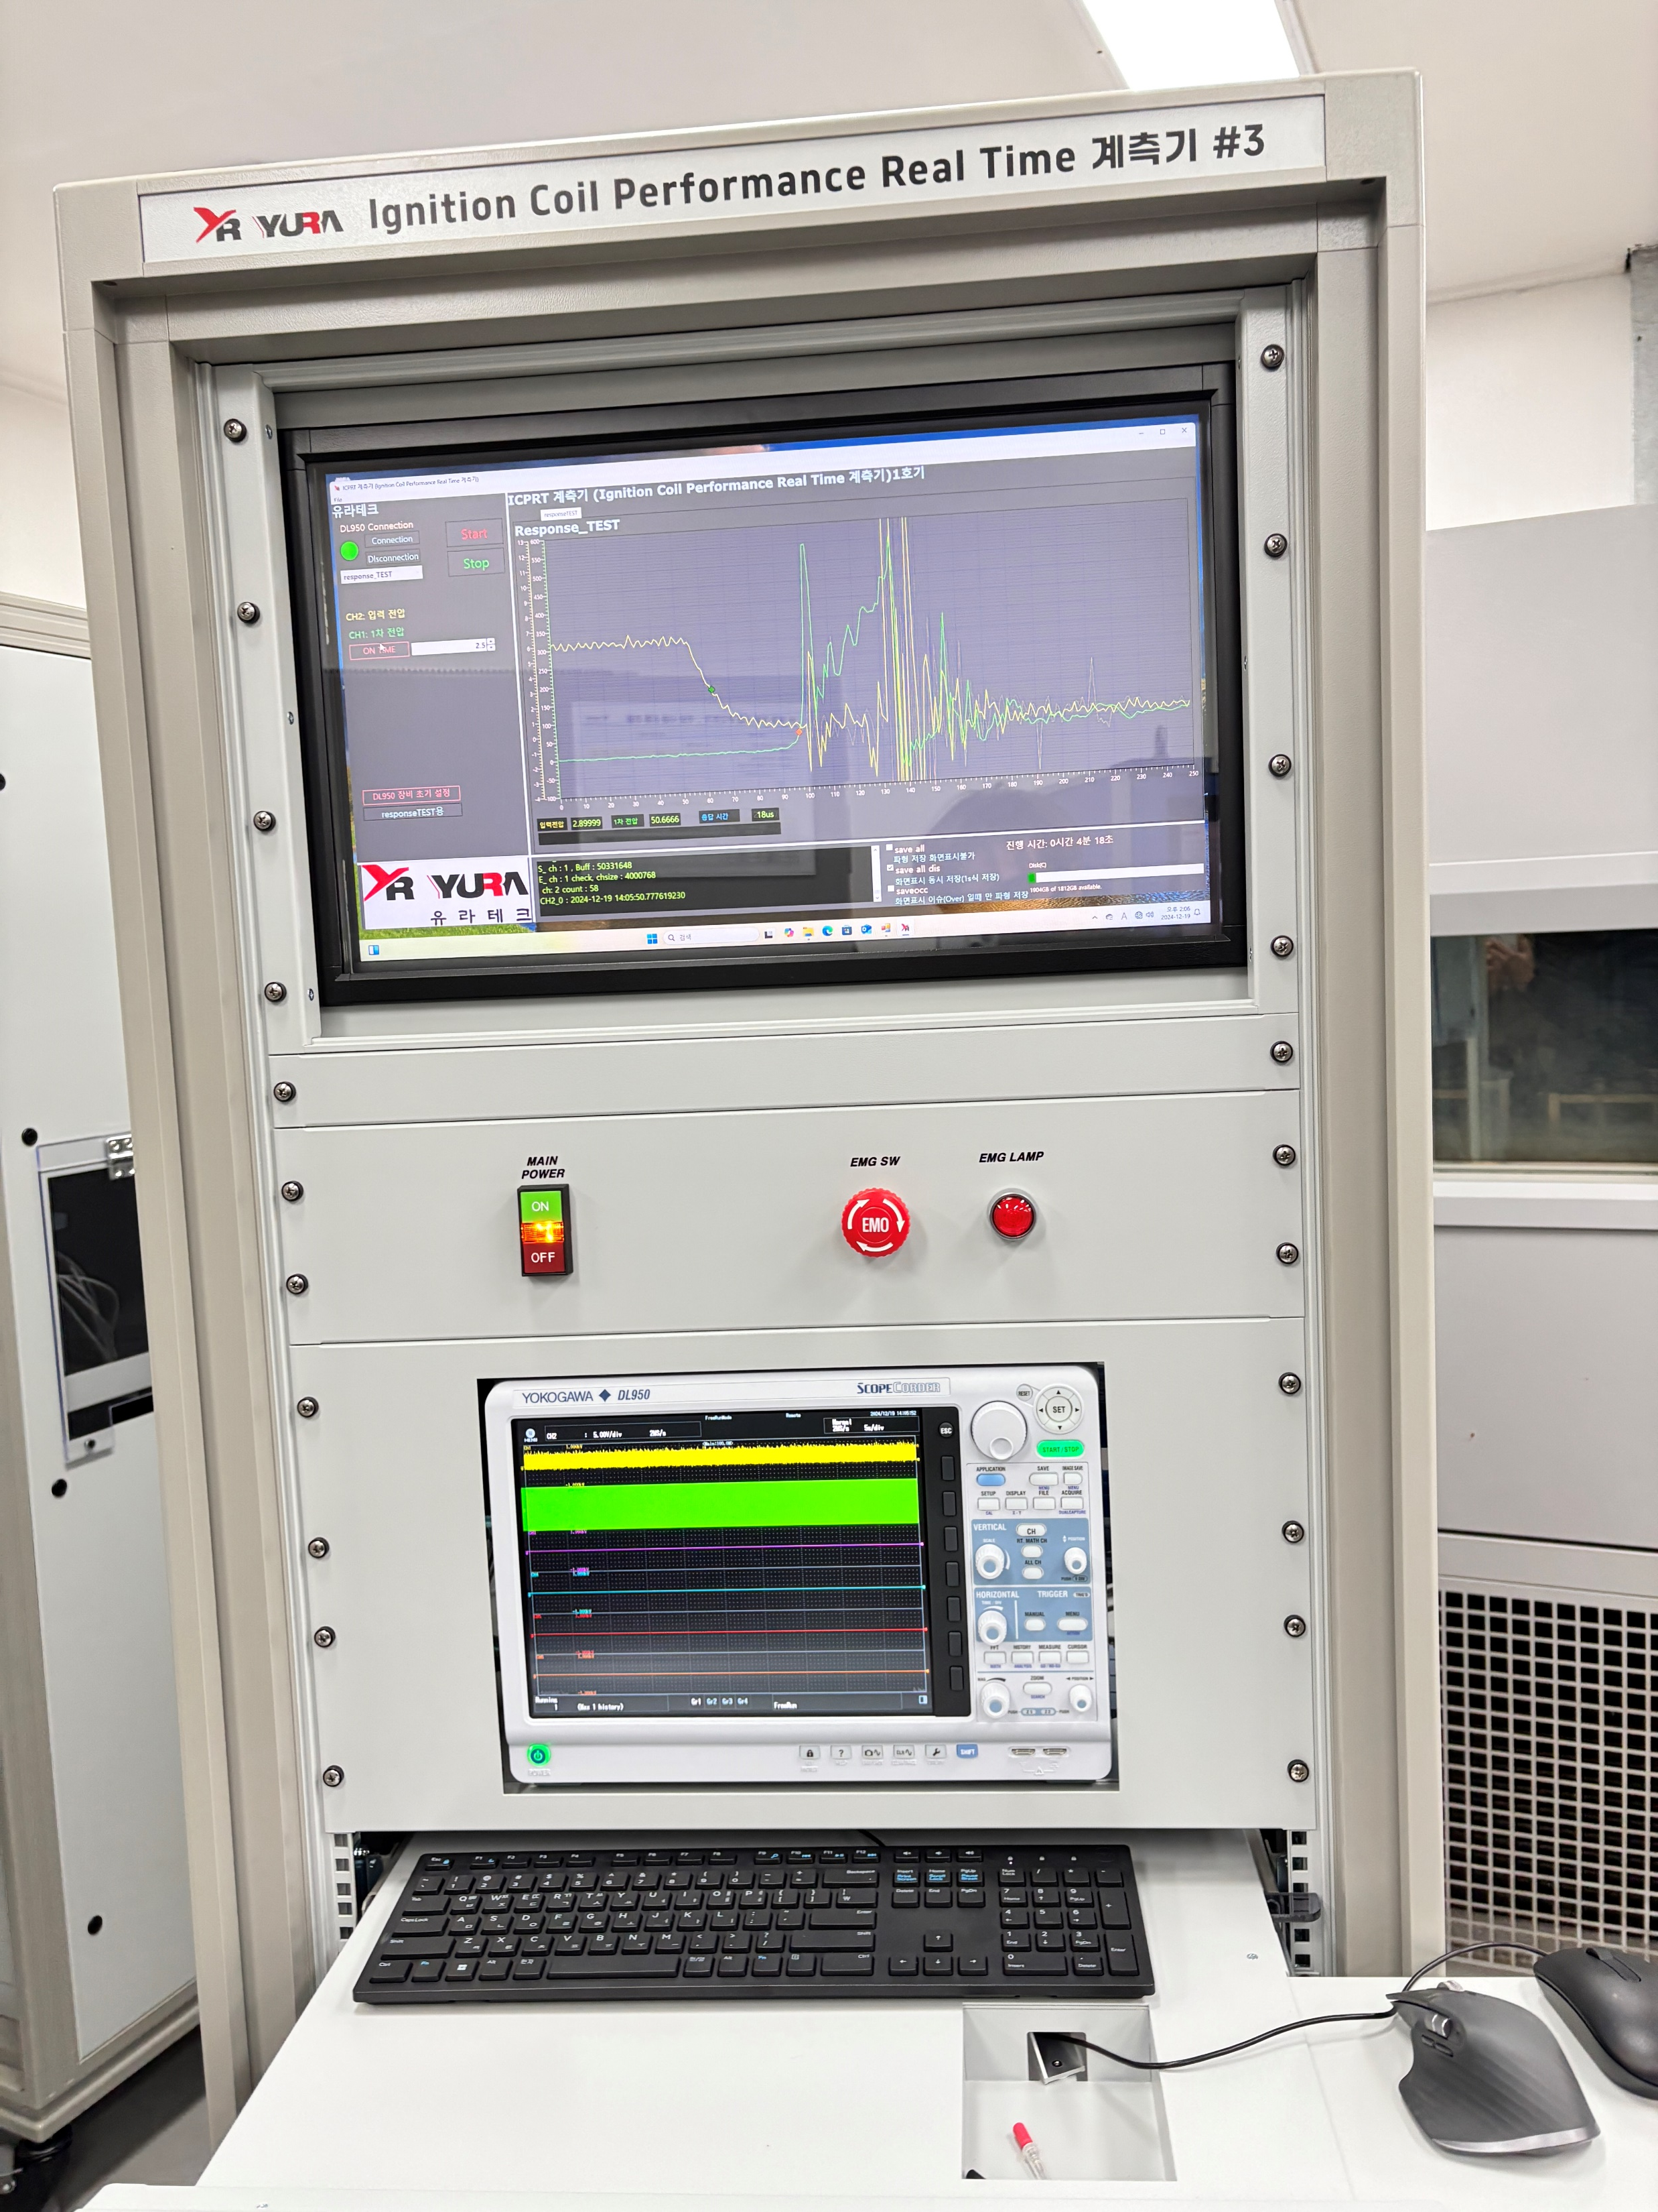
DL950 Success Stories
Spark plug durability System - Drive photos

Slide 8
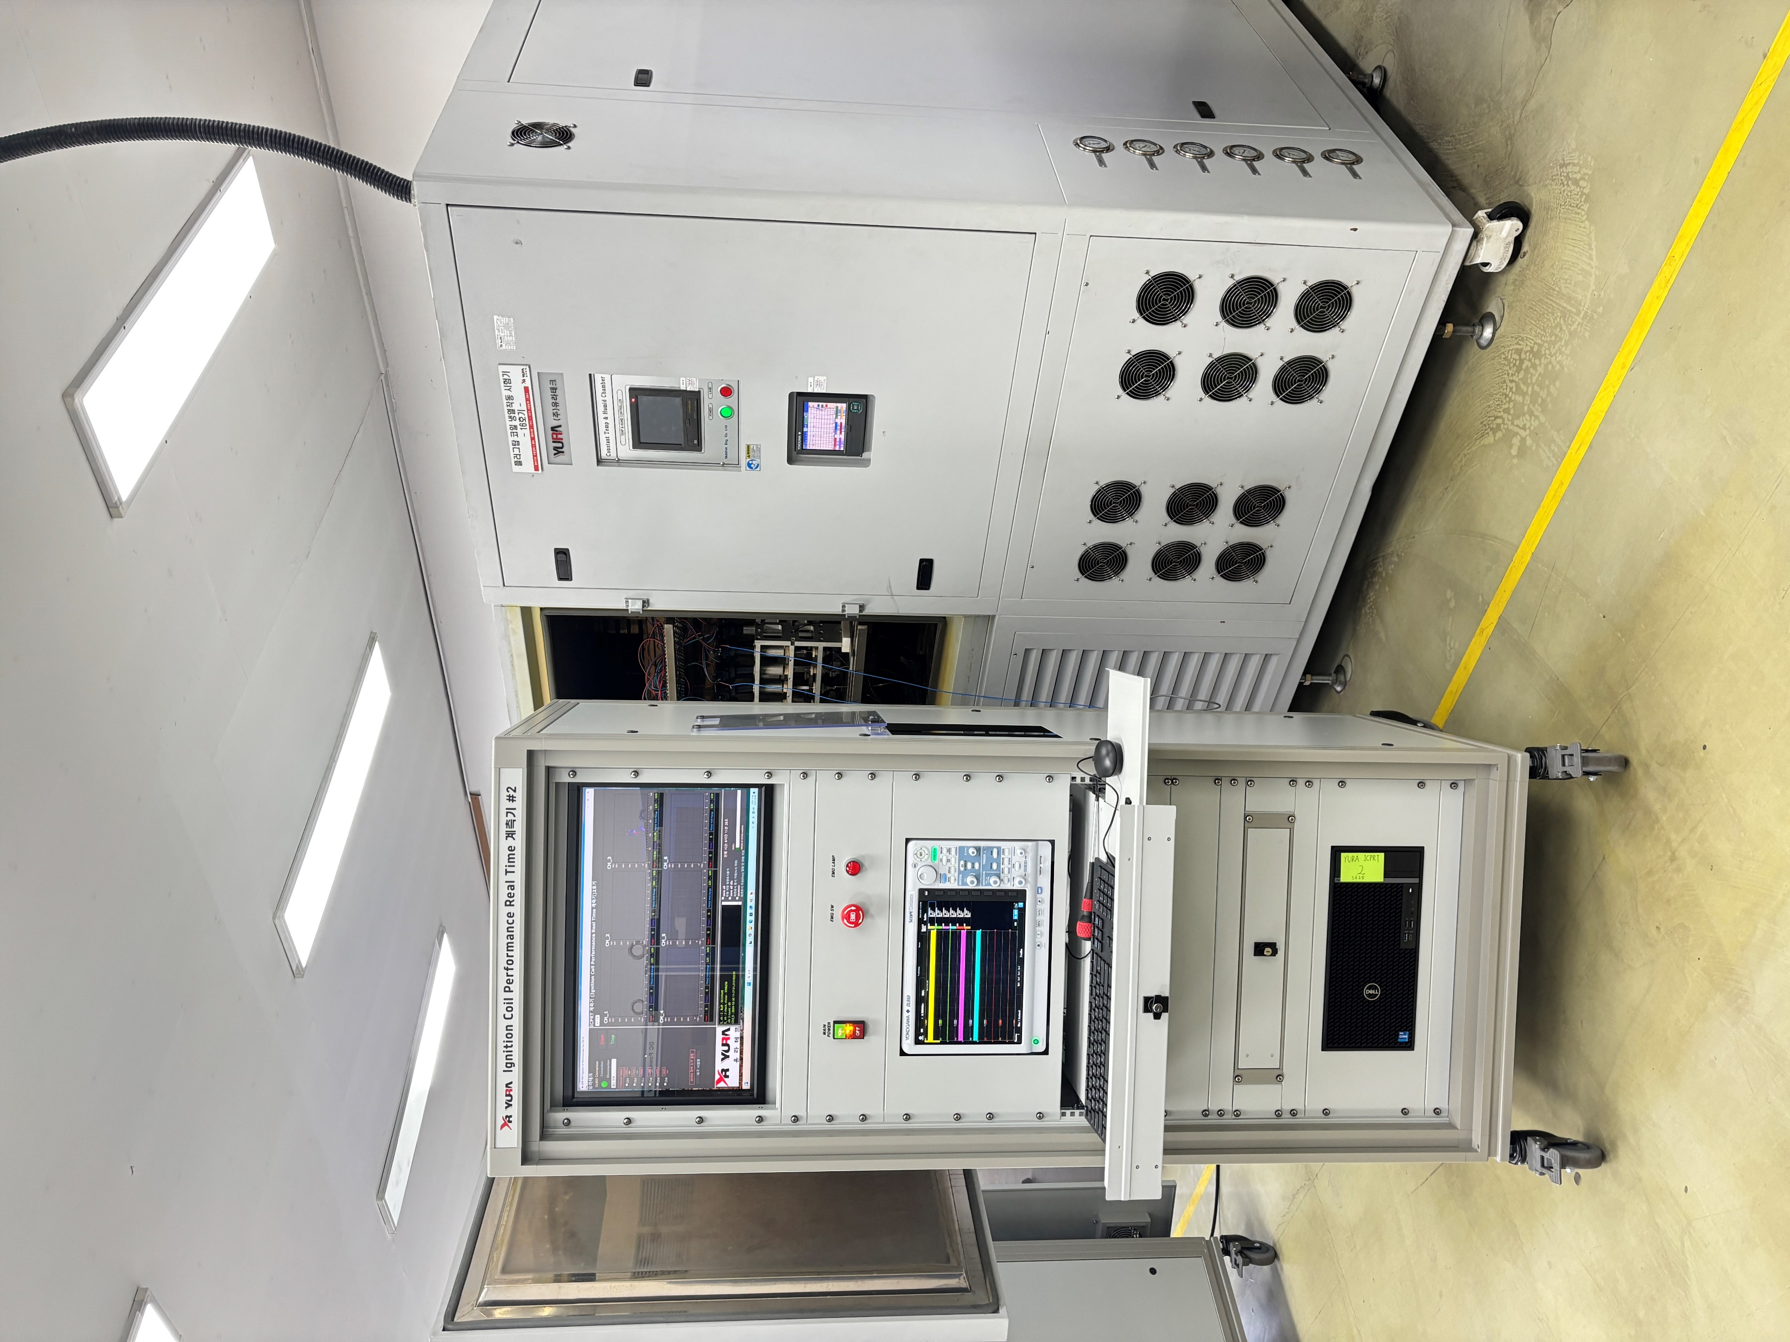
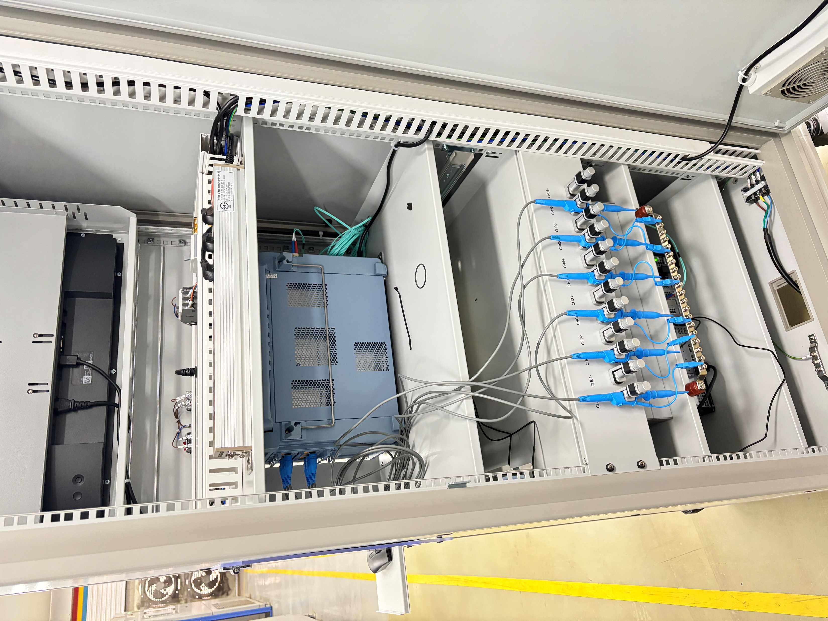
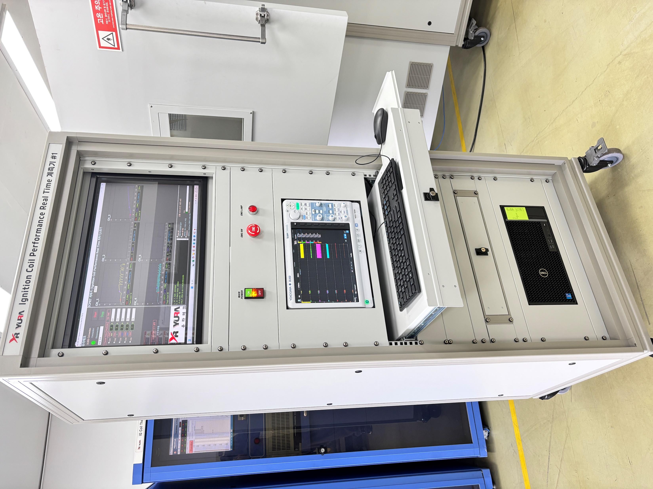
DL950 Success Stories
Spark plug durability System - On-site photos

Slide 9
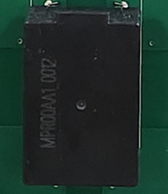
DL950 Success Stories
Pre-charge Relay System
Customer Requirements
DC up to 24V (voltage programming)
3Ch (up to 50A expected when controlled simultaneously) or 6Ch (up to 100A expected)
Monitoring, data storage, operation On/Off repeat control, overcurrent/high
temperature alarm function,
Voltage operation control required according to each temperature and humidity
chamber pattern section
Key components that connect and disconnect electric vehicle (EV) batteries and inverters/chargers
DUT – Pre-Charge Relay
Notes:
DC 최대 24V (전압 프로그래밍) DC up to 24V (voltage programming)
부하 : DC 450~800V, 프리차지저항 50옴(저항 변동 有), 커패시터 1000㎌
3Ch(동시 제어 시 최대 50A 예상) or 6Ch (최대 100A 예상)
모니터링, 데이터 저장, 동작 On/Off 반복 제어, 과전류/고온 알람 기능,
항온항습기 패턴 구간 별에 따라 전압 동작 제어 필요
전기자동차(EV) 배터리와 인버터/충전기를 연결 및 차단 하는 핵심 부품
배터리의 과충전 및 과방전 방지
배터리 과열 방지

Slide 10
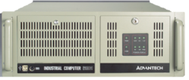
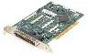
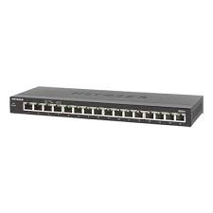
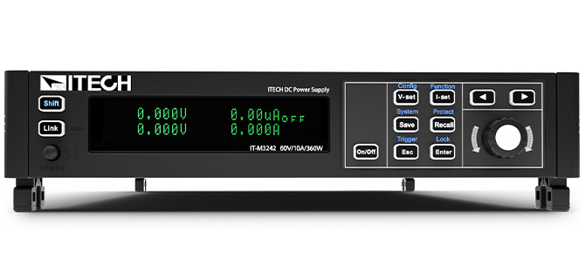
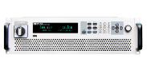
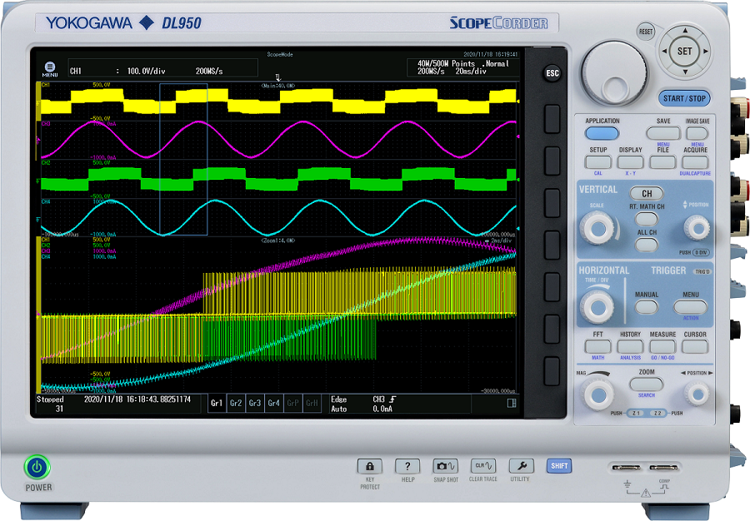
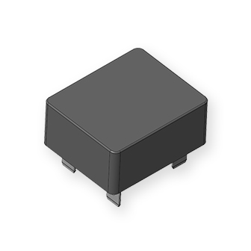
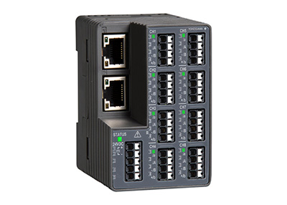
DL950 Success Stories
Pre-charge Relay System – H/W
Power Rack
Group Control(6CH, 12V)
Dis-charge Relay(3CH, 12V)
PCI
DIO B/D
Industrial PC
Pre-charge Relay(3CH, 0~24V)
PCI
DIO B/D
Ethernet
전압 센싱
DC SOURCE
전류 센싱
DC SOURCE
Current (3CH)
Low Voltage(12V, 3CH)
High Volage(800V, 3CH)
DL950
전압 센싱
Temp(8CH)
VZ20X
Pre-Charge Relay

Slide 11
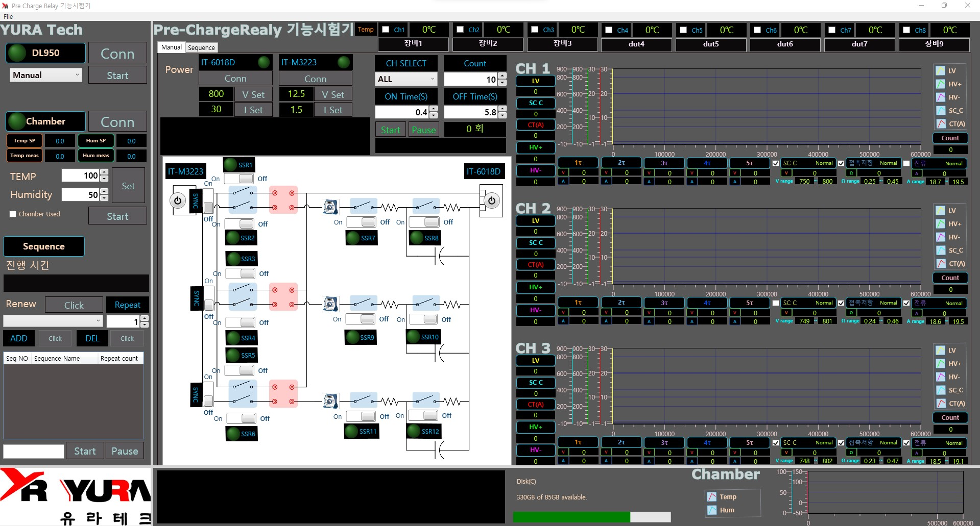
DL950 Success Stories
Pre-charge Relay System – S/W Program
-ON OFF TIME Control Operation
-Chamber Control
-Tau Calculation Contact
-Resistance Calculation
Notes:
ON OFF TIME 제어 동작
챔버 제어
Tau 계산
접촉저항 계산

Slide 12
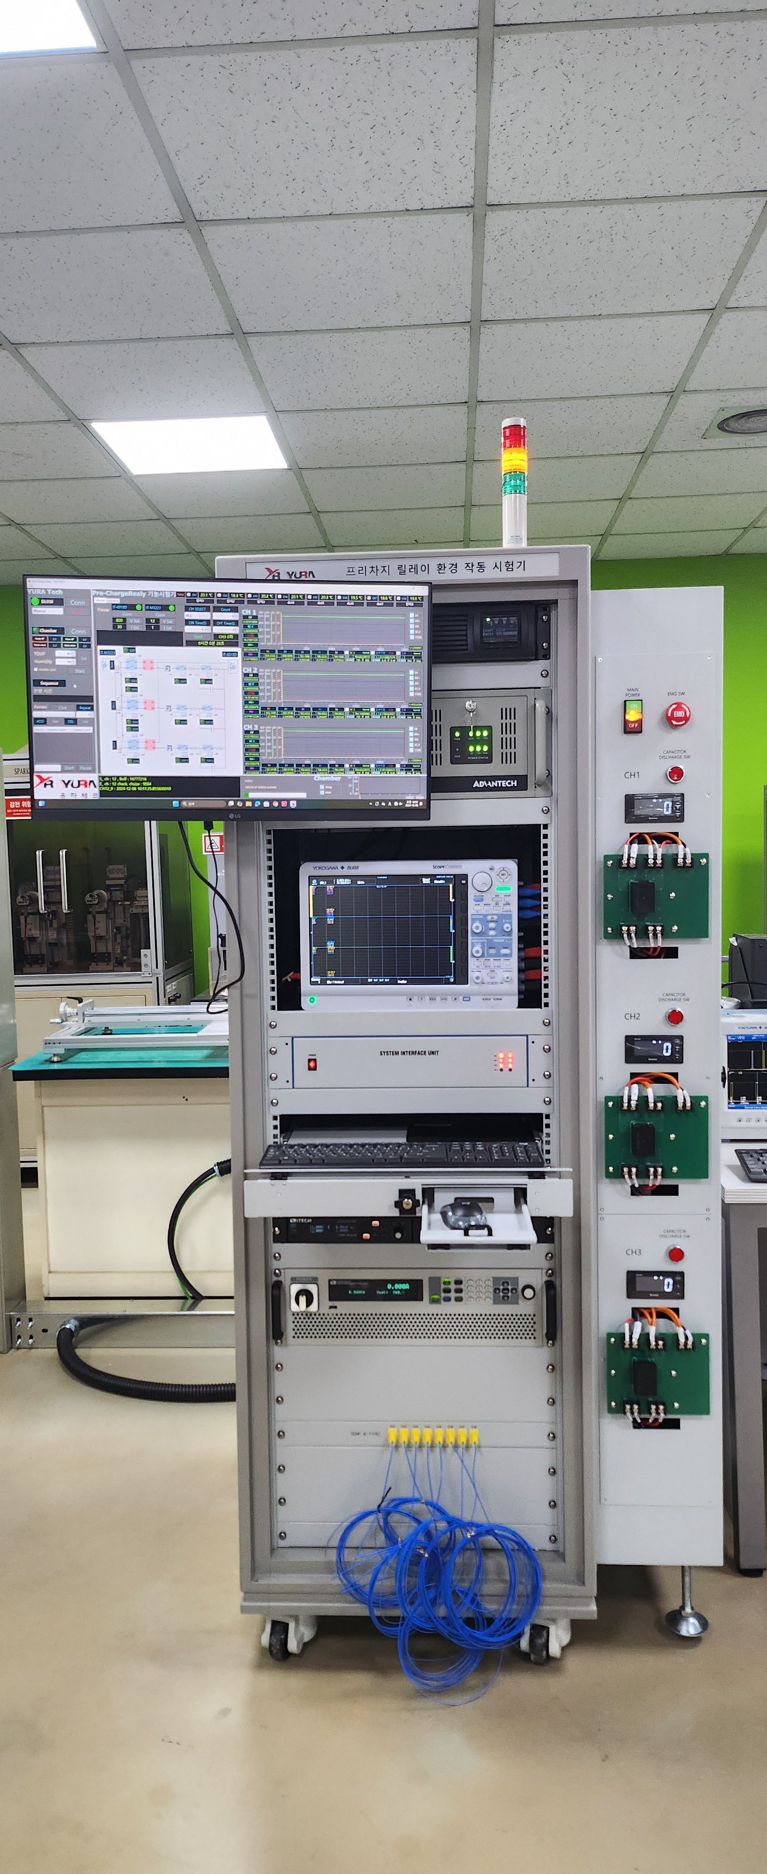
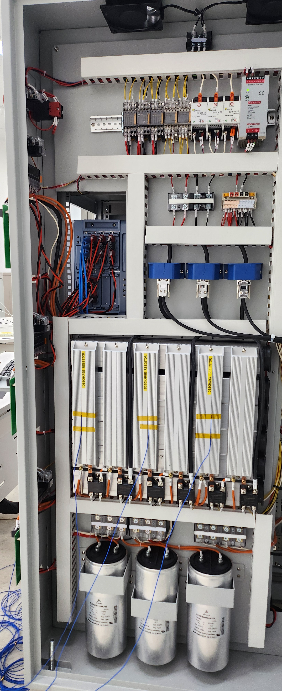
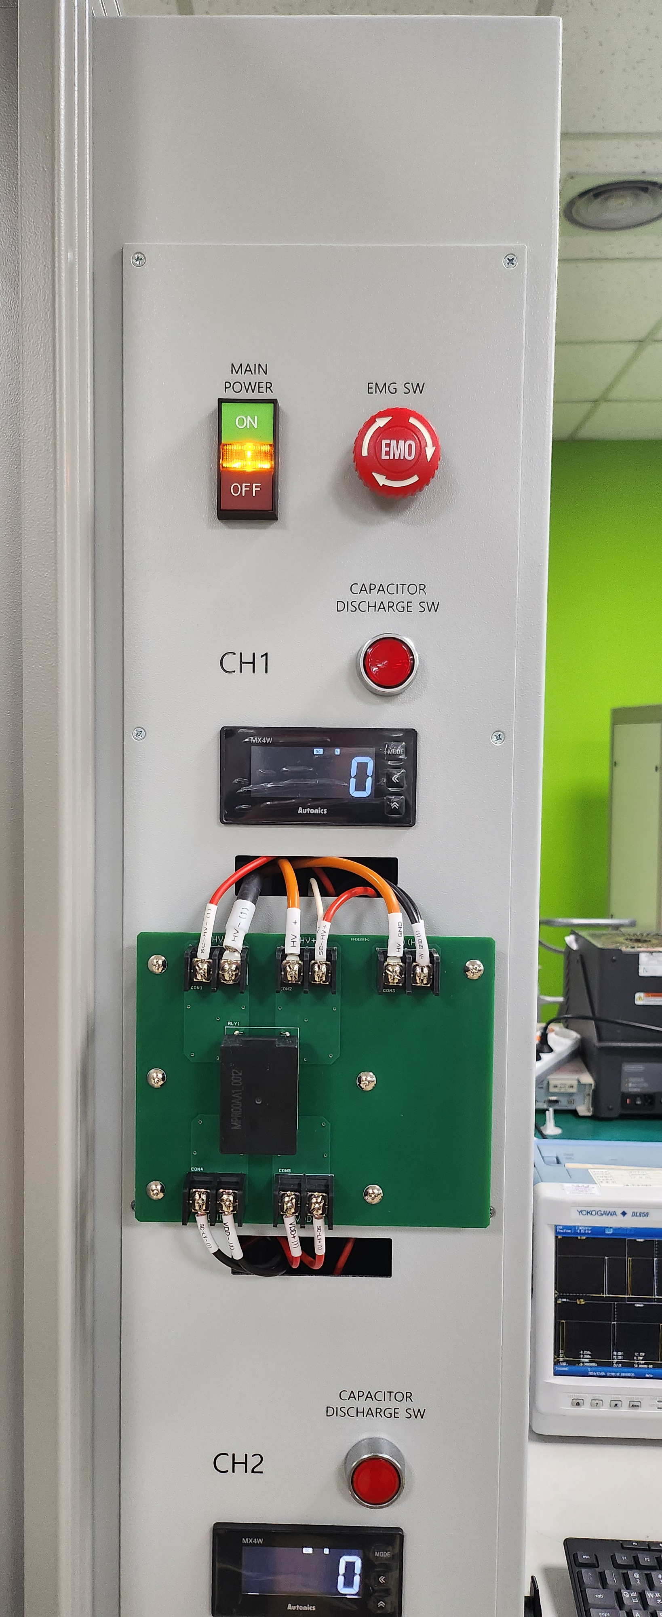
DL950 Success Stories
Pre-charge Relay System - On-site photos

Slide 13
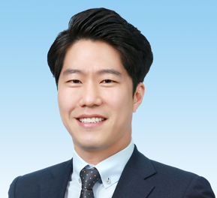
Self introduction
Profile
Career
Pre-Charge Relay Tester
Woojin
Li-ion Battery Charge/Dis-Charge Tester
KyungshinHoldings
EOL Tester for BDU Function
YURA Corporation
EOL Tester for ICCB Function tester
YURA Corporation
Name : Jung Seungbae(丁陞陪)
E-mail : seungbae.jung@yokogawa.com
Birthday : 1982.01.23
Place of birth : Yangsan-si, Gyeongsangnam-do, Korea
Work(Assigned Task)
Programs Developer for PC Based Application
Development Tools : LabVIEW, C#

Slide 14

DL950 Success Stories
Customer Information
Company title: Woojin Industry Company Ltd.
Establishment: May, 1966
CEO: Ryu Si Hyuck
Location: 248, Sandan-ro, Danwon-gu, Ansan-si, Gyeonggi-do, Republic of Korea
Customers: Hyundai, Kia, GM, etc.
Products: Spark Plug, Oxygen Sensor, Glow Plug, etc.
Sales: 218.66599 billion won

Slide 15
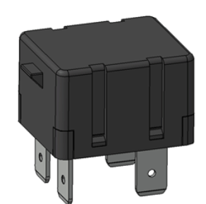
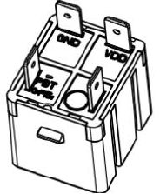
DL950 Success Stories
DUT(Device Under Test) Specifications
EPR, Electronic Pre-charge Relay
Item | Spec. | Remark
Coil Voltage | 8~16Vdc | Max. 650 Vdc(Output)
Current Rating(Output) | 11.25A | 450Vdc, 40Ω, 1000uF(Output)
Pick Up Voltage | 8Vdc Below
Drop Out Voltage | 3.1 +/- 0.5Vdc | 12Vdc, 1kΩ @ 20℃(Output)
Operate Time | 0.1 ~ 1.0ms
Release Time | 0.8 ~ 3.8ms
Pickup current | 5 ~40ms
Contact Resistor(Output) | 0.5 ~ 1.2Ω | 12Vdc, 1A @ 20℃(Output)
EPR
As a PRA SUB part, it operates before the main relay operates and reduces the voltage difference within the circuit to prevent main relay overload.
Test Specification
Durability test, Environment reliability test and Mechanical reliability test for EPR
HYUNDAI MOTOR Engineering Standard

Slide 16
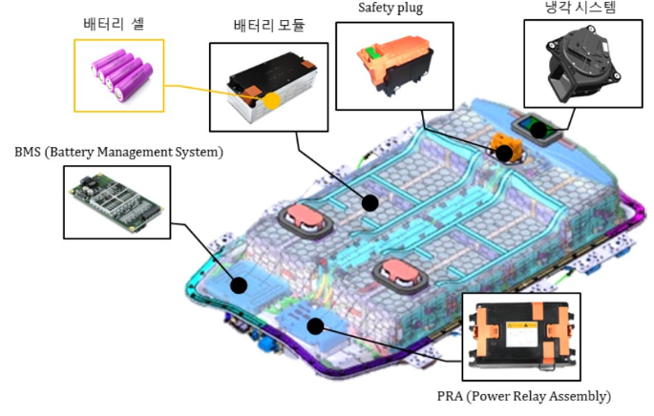
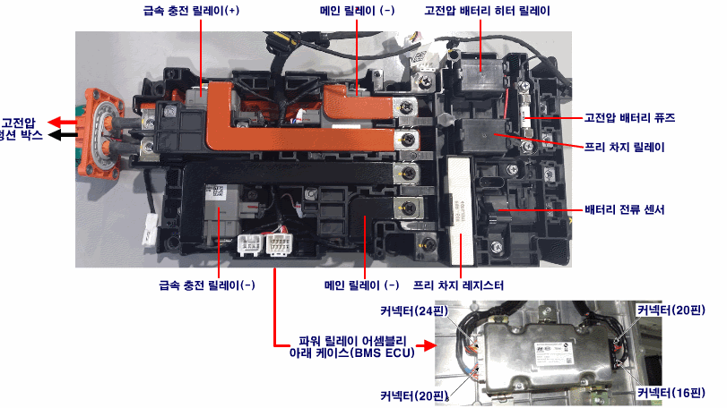
DL950 Success Stories
What is the EPR?
PRA
The Power Relay Assembly (PRA) is a component that supplies and cuts off power for discharging or charging the high-voltage battery.
It is installed in the high-voltage battery system assembly (BSA) and electrically connects the battery and the inverter.
Applicable components include main relay, pre-charge relay, resistor, current sensor, temperature sensor, bus bar, etc.
Pre-Charge Relay
As a PRA SUB part, it operates before the main relay operates.
reduces the voltage difference within the circuit to prevent main relay overload.
Notes:
배터리의 가장 기본 단위인 배터리 셀은 3.6V ~ 3.7V의 전압을 가지고 만든다.
Battery cells, the most basic unit of a battery, are made with a voltage of 3.6 V to 3.7 V.
전기차를 구동하는데 필요한 만큼 직렬로 쌓아서 모듈을 만들고 이를 모아서 배터리 팩을 만든다.
Battery cells are modularized to be the battery package by making the cells integrated as they are needed.
전기차의 배터리 전압은 보통 400V 가까이되며, 배터리 용량은 60kWh가 넘는다.
Normally, EV voltage is about 400V, battery capacity is 60kw over.
이렇게 높은 전력을 모터로 공급하고 차단하는 역할은 PRA(Power Relay Assembly)가 담당한다.
PRA에는 고전압을 제어하는 메인릴레이와 한 번에 갑자기 높은 전압이 들어와 인버터가 손상되는 것을 막기 위한 프리차지 릴레이로 구성되어 있다.
PRA is in charge of the role for handling power flow whether to supply or stop the power.
Pre-charge relay is placed in the PRA. This is to prevent the main power overload suddenly.
At that movement, the main relay is connected to the main circuit, there are some problem like spark or surge high voltage.
It is so dangerous like short circuit or open. These situations could cause many malfunctions.
Ev is very important to handle the battery because of fire risk.
Most accident are occurred at just simple problem.
Pre charge relay is the first component to prevent this risk. It is so important.
----------------------------
차를 움직이고, 회생 제동이나 급속 완속 충전하는 과정 모두 PRA를 통해서 고전압 배터리로 에너지가 전달된다.
And the performance of the battery is diagnosed through current and temperature monitoring.
-Prevent overcharge and overdischarge of batteries
-Prevent overheating of batteries

Slide 17
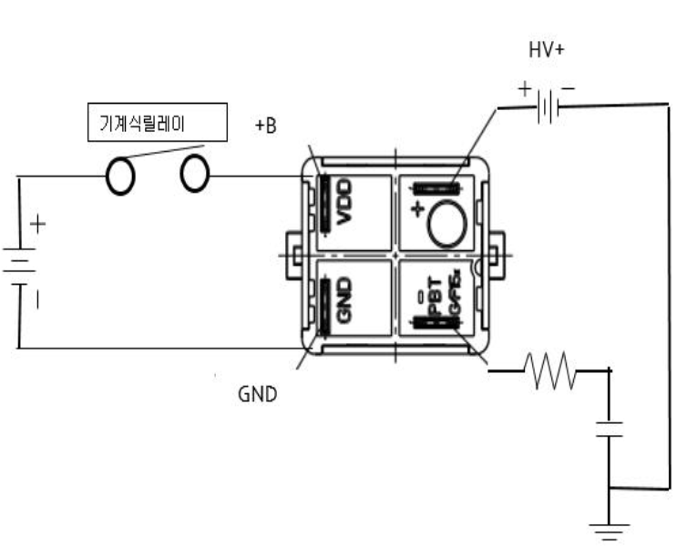
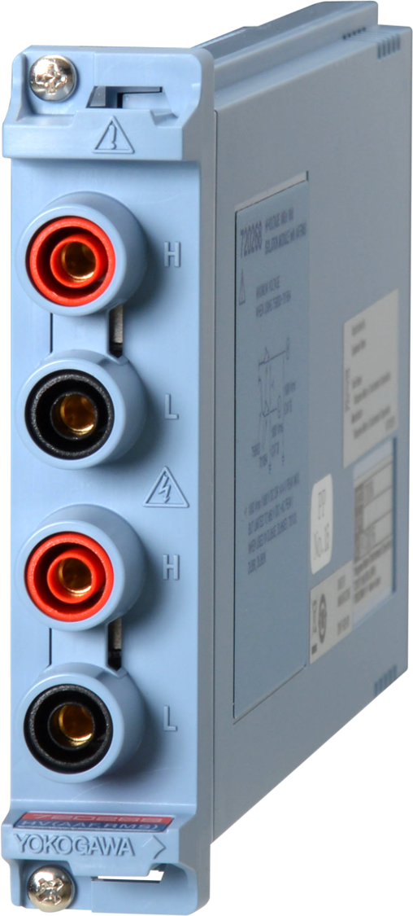
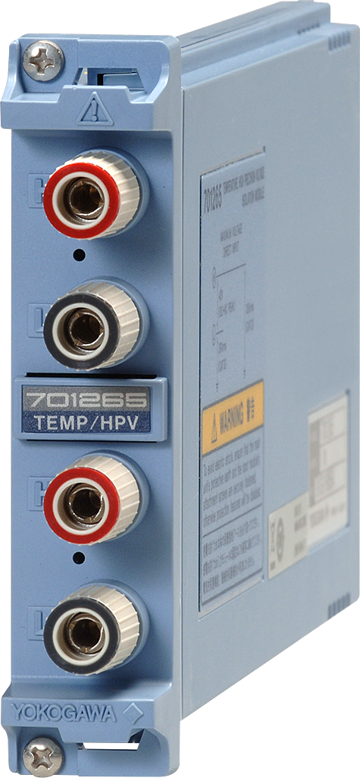
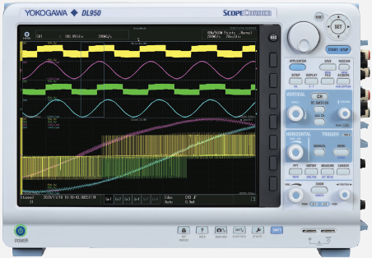
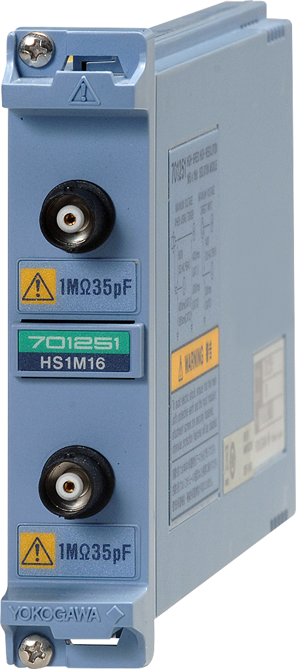
DL950 Success Stories
DL950 Modules for DUT test solution
720268 High Voltage Module 1MS/s
701265 High-Precision Temperature Input Module
450V
20A
Iout
Vout
12V
1A
Vin
TC
Vcap
DL950
40Ω
701251 Analog Voltage Input Module
Iin
1000uF
DC Link
Notes:
This is signal flow and block diagram about test solution.
You know, we used our product dl950 for testing DUT like this.
There are 3 points for voltage measurement from input output of DUT.
2point are current signals and 1 point is temperature.
They consist of several modules such as 720268 module for voltage measurement, 701251 for current measurement and 701265 for temperature measurement.
Especially, we should handle the high voltage about 800V. We should provide the isolation solution. We had a solution that we could use our product 720268. That was the isolation solution.
8 slot Dl950 has enough specification to collect all these signal.
We could decide to provide the dl950.

Slide 18
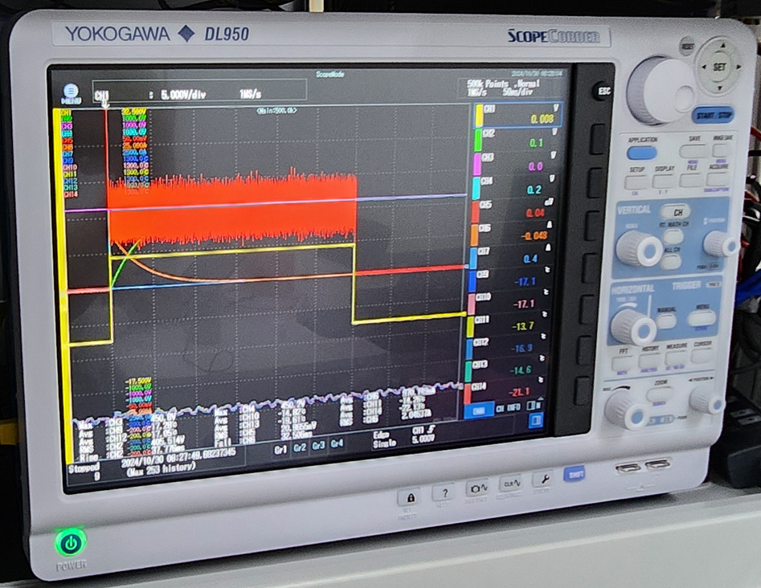
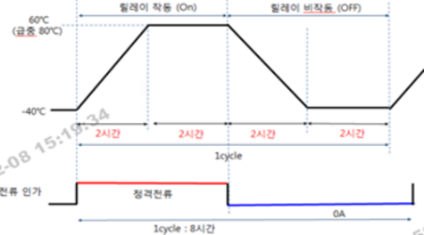
DL950 Success Stories
DL950 Solution for ES Test of High Voltage Relay
Items & Waveform triggered
EPR
Voltage(720268)
Current(701251)
Temperature(701265)
Triggered signals
Temperature Cycle Test(ES)
Sending command for handling DL950
:CHANNEL1:DISPLAY OFF;:CHANNEL2:DISPLAY OFF;:CHANNEL3:DISPLAY OFF;:CHANNEL4:DISPLAY OFF;:CHANNEL5:DISPLAY OFF;:CHANNEL6:DISPLAY OFF;:CHANNEL1:DISPLAY ON;:CHANNEL2:DISPLAY ON;:CHANNEL3:DISPLAY ON;:CHANNEL4:DISPLAY ON;:CHANNEL5:DISPLAY ON;:CHANNEL6:DISPLAY ON;:CHANNEL7:DISPLAY ON;:CHANNEL8:DISPLAY ON;:CHANNEL9:DISPLAY ON;:CHAN1:VDIV 100;:CHAN2:VDIV 100;:CHAN3:VDIV 100;:CHAN4:VDIV 100;:CHAN5:VDIV 0.005;:CHAN6:VDIV 5;PROB C10;:STOP;:MEASURE:CHANNEL1:ALL OFF;:MEASURE:CHANNEL2:ALL OFF;:MEASURE:CHANNEL3:ALL OFF;:MEASURE:CHANNEL4:ALL OFF;:MEASURE:CHANNEL5:ALL OFF;:MEASURE:CHANNEL6:ALL OFF;:MEASURE:TRANGE -5.05,0.15;:MEASURE:CHANNEL1:RISE:STATE.
…
Notes:
We choose the normal mode trigger and use the level trigger method to get all the signals.
They have different signal level from the input and output signal.
We set the vertical division differently in each channel.
Also we did set the other properties such as time division, record length and measure items.
They request the test method Hyundai ES like this process. Relay should be operated in the red line and relay off in the blue line.
Relay is placed in the chamber to do the ES test like durability, environment, mechanical reliability.
Chamber is operating cycling mode with changing the temperature -40degree to 60degree.
This is just one of them for ES test. To test the mechanical vibration of the sample, they used a mechanical chamber.
Dl950 is waiting the trigger signal for the data what they need.
We did set the dl950 to get the triggered data like this.
There are command more handling dl950.
Set the dl950 and then get the signal and then received the data and then process the data on the PC application.

Slide 19
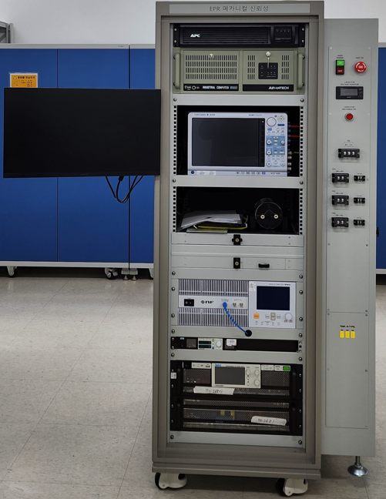
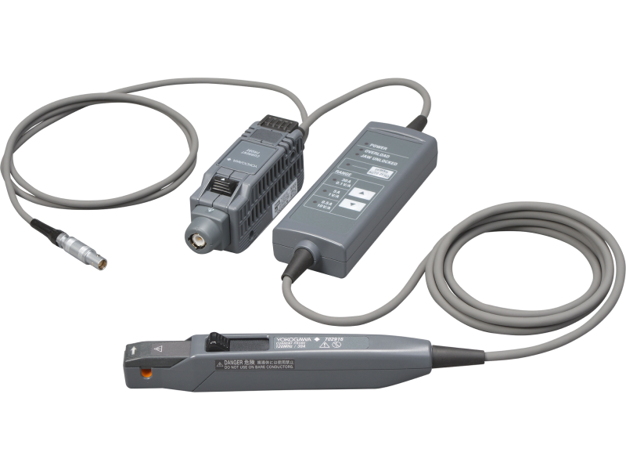
Mechanical & Environment Test, 2EA
Test System
DL950 Modules used
720268 High Voltage Module 1MS/s
701265 High-Precision Temperature Input Module
X 2
X 2
701251 Analog Voltage Input Module
702916 Current Probe 120 MHz/ 0.5 ARMS, 5 ARMS, 30 ARMS
X 1
X 1

Slide 20
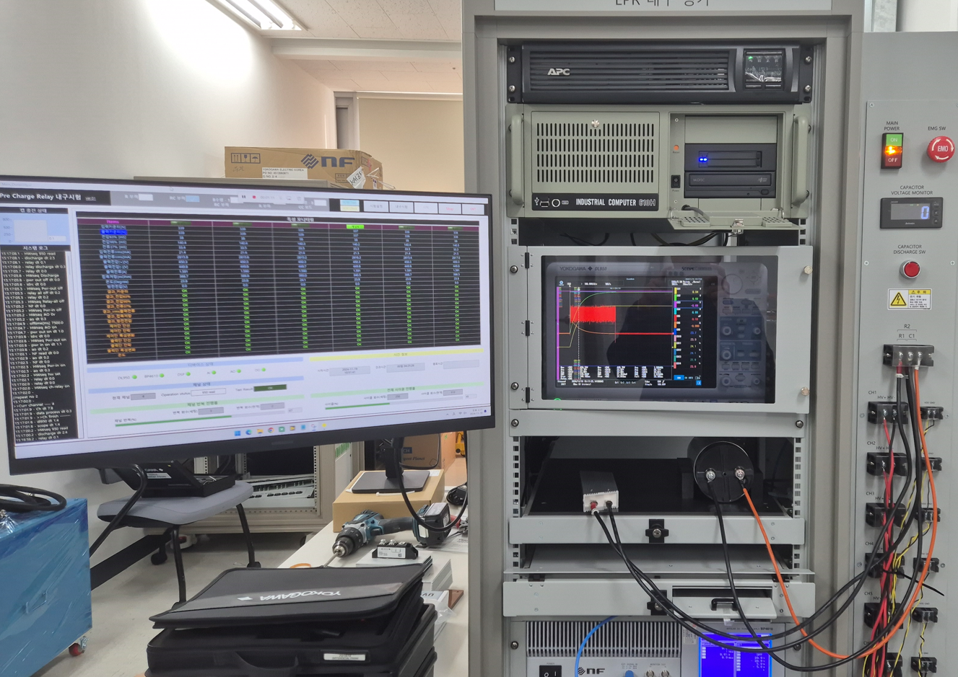
Durability Test, 1EA
Test System
DL950 Modules used
720268 High Voltage Module 1MS/s
701265 High-Precision Temperature Input Module
X 2
X 3
701251 Analog Voltage Input Module
702916 Current Probe 120 MHz/ 0.5 ARMS, 5 ARMS, 30 ARMS
X 1
X 1

Slide 21
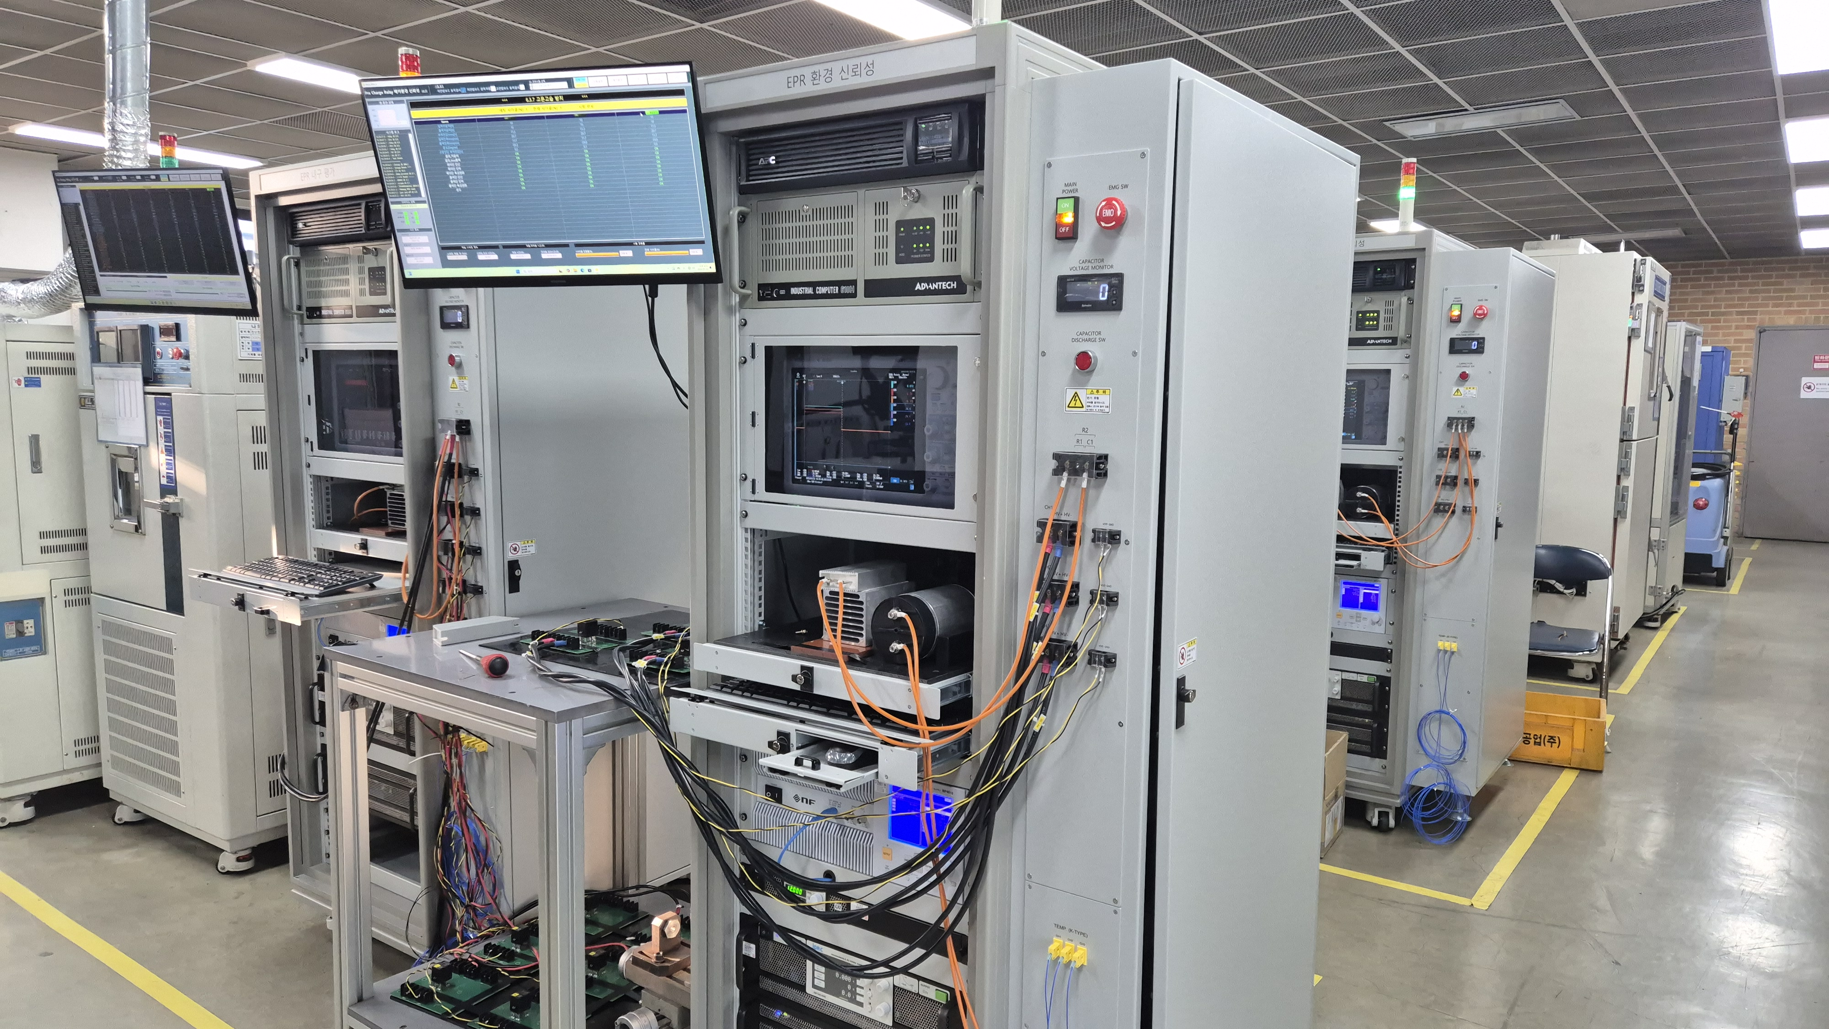
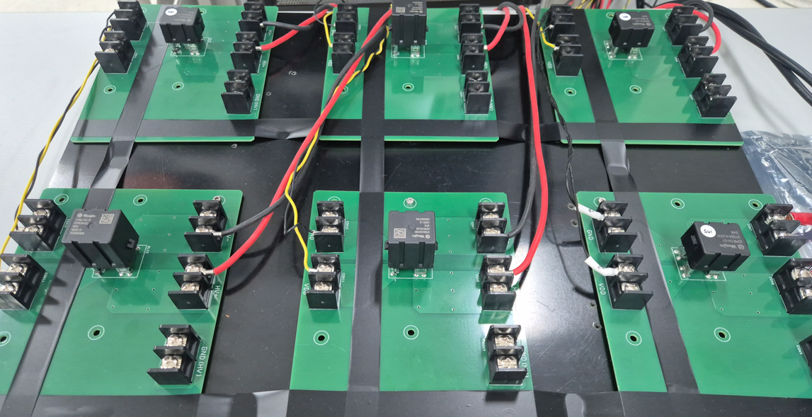
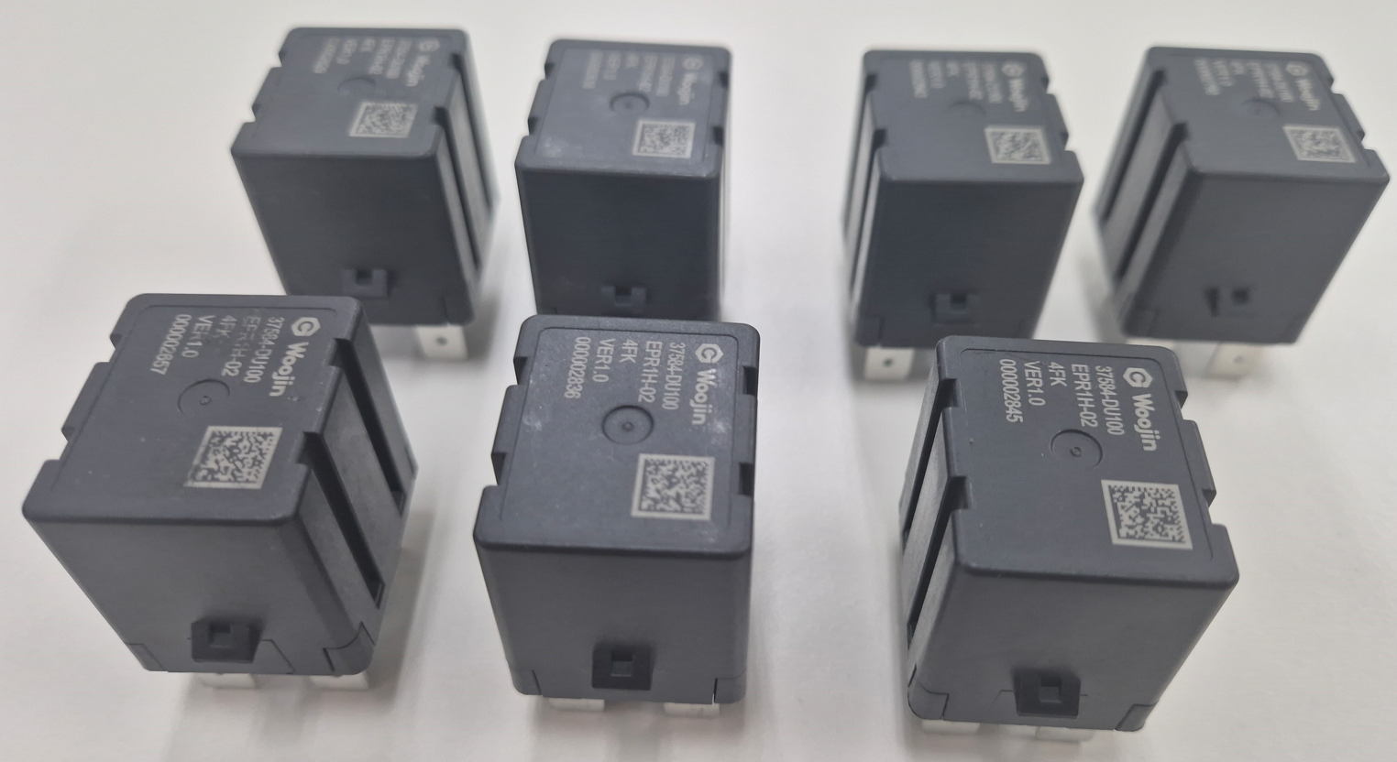
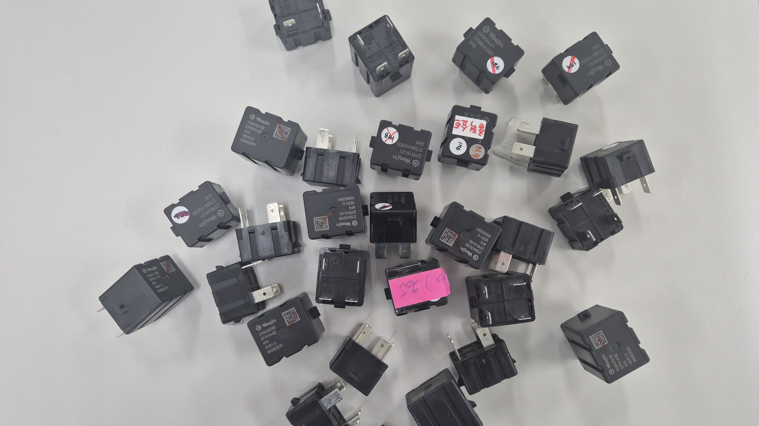
DL950 Success Stories
System solutions for installed customer sites
Sample JIG
DUT(Pre-Charge Relay)
Failed Sample (during work)

Slide 22
DL950 Success Stories
Movie Link

Slide 23
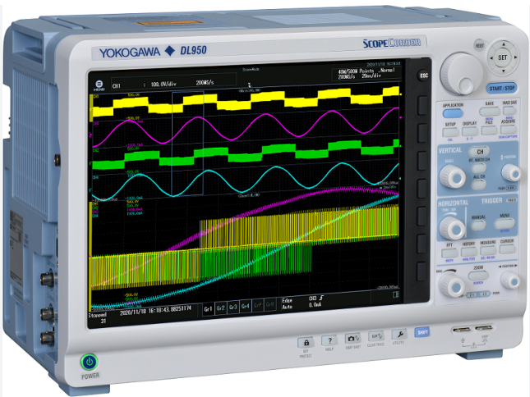
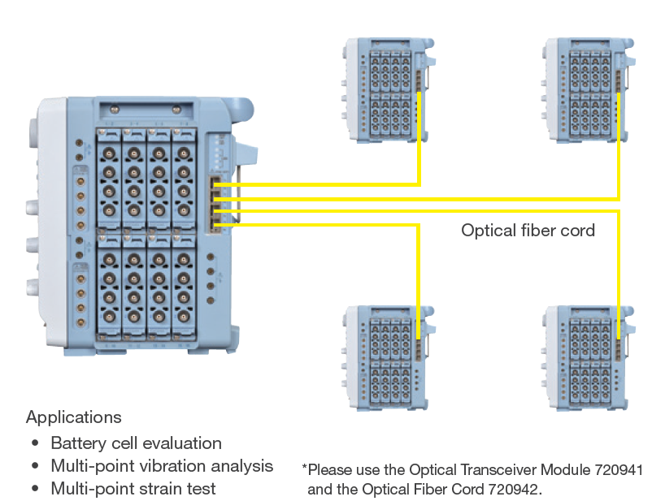
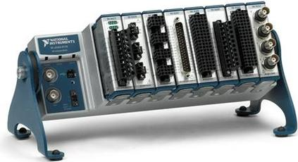
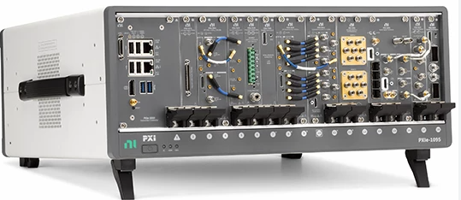
Expectations for DL950
T&M System
It is expected to be a device that can replace NI DAQ products based on noise processing and isolation.
Replacement for Test Solution
NI compactDAQ
NI PXI
Notes:
T&M System 경우
노이즈 대응 및 절연 가능 하고
NI DAQ 제품들을 대체 하여 앞으로 개발 할 SYSTEM용으로 사용 예상 됨

Slide 24
Sales opportunity of DL950
Samsung MX Division (Mobile)
1unit
Circuit board duration & current test
Stats Chip pack Korea
1unit
Semiconductor duration & looping test
Posco
2 units
Electricity quality monitoring for electrical substation in steel plant
Keyang Electric Machinery
1 unit
Vehicle sunroof motor test
Notes:
현재 영업쪽에서 진행 검토 중인 JOB들은 다음과 같다.
삼성: 전류채널 48개(전류용량 수 A급), DL950은 보유중이고 모듈을 추가해서 구축(시스템 제안)
반도체 완성테스트(루핑테스트) 2일정도 테스트, 오실로스코프로 대응 불가 DAQ 필요해서 DL950 사용.
포스코 전기품질모니터링(전압/전류/주파수)
계양전기
영업사원들이 현재 진행중이 JOB들이다.

Slide 25
Request for YMI Product (Sales)
Physical Layer Analysis
CAN/CANFD or other serial signal physical layer decoding function like DLM series
Integrated Printer
Integrated printer support instantaneous data output to tangible paper
Heavy industry customers ( Shipbuilding ) started to change DL950 to other high speed DAQ with printer
The market size that can sell DL950 in the maintenance market is bigger. However, the market is being lost due to the absence of a printer. A printer function that can be set up simply and printed is needed.
Weight
Too heavy to carry to the test site
Notes:
- 물리층 분석 기능
: 오실로스코프의 CAN/CANFD 분석 기능처럼 DL950에서도 물리층 분석이 되어야 한다.
판매에 영향을 미친다?
내장 프린터
: 과거 스코프코더에는 프린터가 내장되어 있어서, 현장에서 측정 후 바로 종이로 프린트하여 측정 내용을 확인할 수 있었다.
지금은 내장 프린터가 없어진 관계로, 현장에서 바로 확인이 어렵다.
특히 현대중공업에서는 현장에서 종이로 확인하였는데, DL950에는 안되기 때문에, 최근 타사 제품(히오키)으로 구매하였다.
외장형 프린터 드라이버를 설치하여 사용할 수 있도록 해주시면 좋겠습니다. (OTDR 처럼)
WT1800R 프린터기능이 없어서 불편하다. (동일한 요구가 있다)
메인터넌스 시장에서 DL950을 팔수 있는 시장 사이즈가 더 크다.
하지만 프린터의 부재로 시장을 놓치고 있다. 심플하게 설정하고 출력할 수 있는 프린터 기능이 필요하다.
무게
: 너무 무거워서 현장으로의 이동이 어렵다. (여성 연구원들은 들고다니기 무겁다)
USB C 인터페이스 지원(이지훈 소장)
: 최근에는 VGA 모니터 출력 등을 사용하지 않는다. HDMI 변경 가능?
외장 HDD 나 SSD 도 USB C 포트를 많이 사용한다.
DL950에서도 USB C 포트를 지원해야 한다.
최근 트렌드 반영위해 개선이 필요하다.

Slide 26
Request for YMI Product (Sales)
USB C Interface
USB C interface should be applied(EX : replace VGA to USB C, USB C cable to External SSD)
Measure values order
Measure values order that are displayed in the screen cannot be changed
The order should be edited by user for the better analysis
Integrated DC power
Integrated DC power helps not to carry external power bank or source.
Display size expansion
The screen is relatively smaller than the DLM series. Display size expansion is required.
Notes:
- DC 전원(마이너한 사항)
: 파워 뱅크나 차량용 인버터에서 전원을 끌어 사용할 수도 있으나 무겁고 불편하다. DL950에 DC 전원이 있다면, 좀더 현장에서 편리하게 사용이 가능하다.
이유는 내부 전원시스템이 불안정해진다.
- 메져 값 표시 시 변수 정렬 기능 필요
현재 메져키를 눌러 값을 표시하게 되면, 정해진 순서대로만 스크린에 표시 된다.
고객들은 본인들이 보고 싶은 순서 및 위치에 값이 나오는 것을 원한다.
메져 값이 표시되는 순서에 대한 편집 기능이 있으면 좋겠다.
사용자 정의 메저 값 채널별 그룹핑 가능하도록 개선.

Slide 27
Request for YMI Product (Engineer)
Remote mode key Lock
While in remote mode entire key locked, make us difficult to analysis the trend
At least time axis should be changeable so that trend analysis will be possible
Data acquisition while waiting for Trigger
In some cases, 720221, 701261 are used in same time with voltage input modules
While waiting trigger, there is no way to gather temperature data
LabVIEW Driver
Some commands are missing in LabVIEW driver
The driver should support most of the functions in the communication commands
Notes:
리모트 모드시 키 락
프로그래밍을 통해 데이터를 수신하게 되면, 리모트 모드로 들어가게 된다.
이 떄, 본체 키 조작은 불가능하도록 락이 걸린다.
이런 경우, 시간축(줌) 조작이 어려워, 파형 분석이 어렵게 된다.
특히 줌 조작 등이 되지 않아 파형 분석이 어려운 만큼, 시간축 조정 등 최소한 파형 분석이 가능한 만큼의 키조작은 되도록 해야 한다.
단순 데이터 수집시에는 기능조작이 가능했으면 좋겠다.
트리거 대기 온도 데이터 수신 불가(제가 기능을 전부다 알지 못했지만 조금 불편했던 부분이다.)
트리거를 기다릴 경우, 다른 모듈 예를 들어, 온도 모듈과 같은 채널의 데이터는 수신할 수 가 없다.
때문에, 트리거를 기다리더라도, 온도 값은 받을 수 있도록 조치가 필요하다.
랩뷰 드라이버
현재 랩뷰 드라이버에는 통신 커맨드에서 제공하는 기능 중 일부는 빠져 있는 것으로 보여진다.
때문에, 랩뷰를 통한 프로그래밍시 제한이 발생한다.
가급적 랩뷰 드라이버에서도 통신 커맨드와 동일한 기능 구현이 필요해 보인다.

